Slide 1
Digital AI Assistant
Trien Dau
Haru Chu

Slide 2
Project Members:
Project Advisor:
Trien Dau: M13292604 - dautx@mail.uc.edu
Haru Chu: M13741094 - chuqc@mail.uc.edu
Yu Zhao - zhao3y3@ucmail.uc.edu

Slide 3
Project Goals and Abstract:
Our project aims to develop a cutting-edge Digital AI Assistant, harnessing the power of ChatGPT API, text-to-speech, and speech-to-text technologies. This innovative assistant will enable seamless human-machine interactions, offering natural language understanding and generation, as well as facilitating voice-based communication. By combining the capabilities of ChatGPT with advanced audio processing, our solution will empower users with hands-free, context-aware assistance for various applications, from virtual companions to productivity tools. This project represents a significant step forward in the evolution of AI-driven digital assistants, providing a bridge between the digital and physical realms.

Slide 4
Intellectual Merits:
Integrates state-of-the-art natural language processing (NLP) techniques with advanced machine learning models to create a virtual voice assistant capable of engaging in contextually relevant and coherent conversations.
Explores novel methods for integrating chatGPT capabilities into a voice assistant, enabling more natural and human-like interactions between users and the system.
Implements innovative algorithms for continuous learning, allowing the voice assistant to improve its responses over time based on user interactions and feedback.

Slide 5
Broader Impacts:
The project has the potential to revolutionize the way people interact with technology, making it more intuitive and accessible to a wide range of users, including those with disabilities or language barriers.
By enhancing the user experience and productivity, the project aims to contribute to increased efficiency for future voice assistant models.
The project's focus on privacy and data security ensures that user information is protected, fostering trust and confidence in AI-driven technologies.

Slide 6
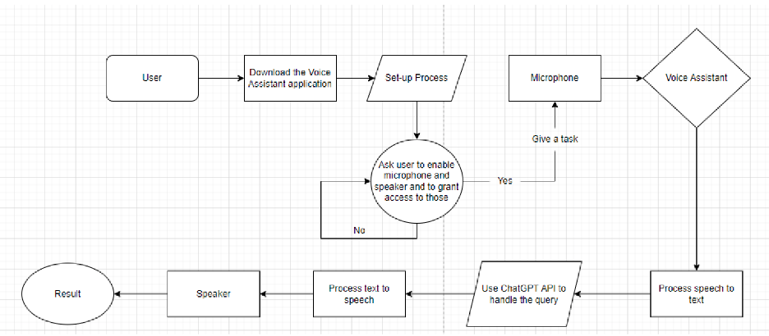
Design Diagram:

Slide 7
Technologies:
Leverages advanced NLP libraries and frameworks, such as spaCy and Hugging Face Transformers, to enable accurate interpretation and generation of human-like text responses.
Integrates voice recognition and synthesis technologies, such as Google Cloud Speech-to-Text and WaveNet, to enable seamless interaction through voice commands and responses.
Employs cloud computing technologies, such as AWS or Google Cloud Platform, to provide scalable and reliable infrastructure for hosting the virtual voice assistant and supporting its functionalities.

Slide 8
Milestones
Milestone 1: Project Initiation and Planning
- Deliverable 1: Project charter and scope document.
- Deliverable 2: Detailed project plan, including timelines, resources, and budget estimates.
Milestone 2: Research and Requirement Gathering
- Deliverable 3: User personas and use cases.
- Deliverable 4: Comprehensive list of functional and non-functional requirements.
Explanation: Understanding user needs and expectations is crucial. User personas and use cases help in shaping the voice assistant's features and capabilities. The requirements document outlines what the system must achieve.
Milestone 3: Technology Stack Selection
- Deliverable 5: Selection of the underlying technology stack, including programming languages, frameworks, and tools.
Explanation: Choosing the right technology stack is vital for building a robust and scalable voice assistant. This milestone ensures that the development team has the necessary tools and platforms in place.

Slide 9
Milestones
Milestone 4: Natural Language Processing (NLP) Integration
- Deliverable 6: Integration of NLP libraries and frameworks.
Explanation: NLP is the core technology enabling chatGPT capabilities. This milestone focuses on integrating NLP components to understand and generate human-like text responses.
Milestone 5: Voice Recognition and Synthesis
- Deliverable 7: Implementation of voice recognition and synthesis capabilities.
Explanation: To mimic Siri-like functionality, the voice assistant needs to recognize and generate voice responses. This milestone ensures the system can understand and produce speech.
Milestone 6: ChatGPT Integration
- Deliverable 8: Successful integration of the chatGPT model.
Explanation: This milestone is the heart of the project, as it involves integrating the chatGPT model, fine-tuning it for conversational use, and ensuring it generates meaningful and context-aware responses.
Milestone 7: User Interface Design
- Deliverable 9: User-friendly voice assistant interface.
Explanation: Designing an intuitive user interface is essential for a positive user experience. This milestone focuses on creating an interface that users can interact with seamlessly.

Slide 10
Milestones
Milestone 8: Testing and Quality Assurance
- Deliverable 10: Test plan and test cases.
- Deliverable 11: Bug-free and stable voice assistant.
Explanation: Rigorous testing is crucial to identify and fix any issues. This milestone ensures that the voice assistant operates smoothly and reliably.
Milestone 9: User Acceptance Testing (UAT)
- Deliverable 12: UAT plan and results.
Explanation: UAT involves real users testing the assistant to ensure it meets their needs and expectations. The results help in making final adjustments and improvements.
Milestone 10: Deployment and Launch
- Deliverable 13: Deployed voice assistant.
Explanation: This is the culmination of the development process, where the voice assistant is deployed for public use.

Slide 11
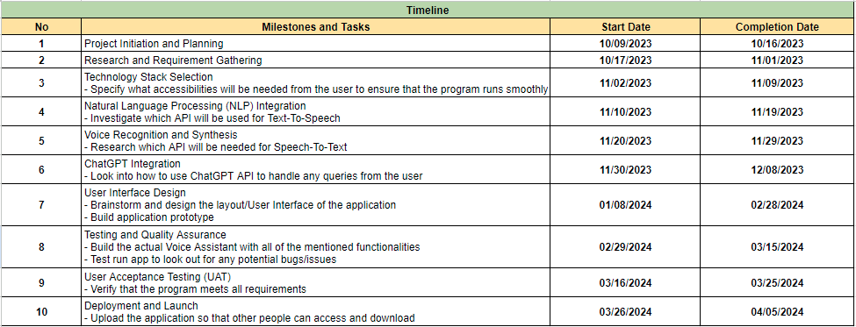
Deliverable Dates:

Slide 12
Review of Project Progress:
Studied the ChatGPT API, Text-to-speech, and Speech-to-text.
Discussed and agreed on the platform and programming languages to be used for this project.
Planned out project outline to make sure everything will be completed on time.
Brainstormed and designed the first draft for the application.
Created the first prototype of the application
Successfully included ChatGPT API functionality
Expected accomplishments:
Add in more functionality to the Voice Assistant.
Export as an application.
Fully test all functionalities to avoid possible errors.

Slide 13
Expected Demo at Expo:
A working Digital AI Assistant with all of the mentioned functionalities, which can listen to users’ prompts and giving back results based on those inputs.
It should be able to answer most questions from the users and provide meaningful outputs.

Slide 14
Challenges:
Integration of ChatGPT: One of the significant challenges was integrating the chatGPT model into the voice assistant to enable natural and contextually relevant conversations. My contribution to this challenge was researching and implementing the necessary APIs and libraries to seamlessly integrate the chatGPT model, ensuring that it responded appropriately to user inputs.
Performance Optimization: Optimizing the performance of the voice assistant, especially in terms of response time and resource utilization, was a constant challenge. My contribution to this challenge involved profiling and analyzing performance bottlenecks, implementing caching mechanisms, and optimizing algorithms to improve overall performance.

